Slide 1
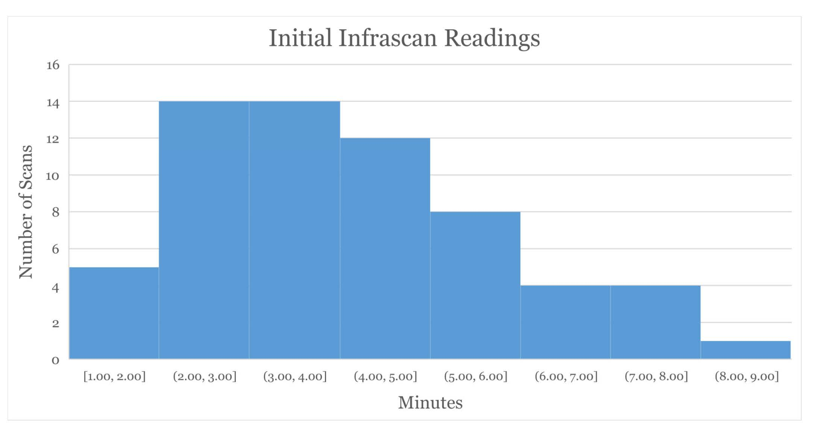
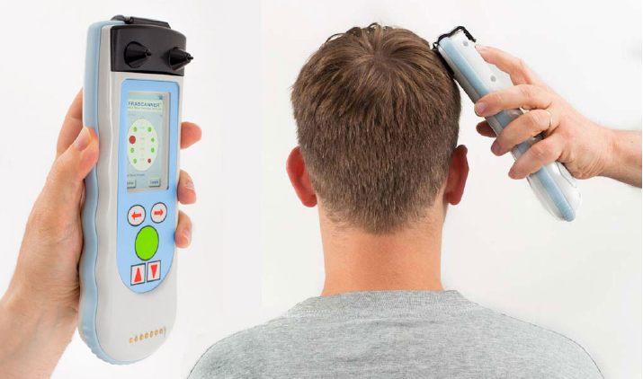
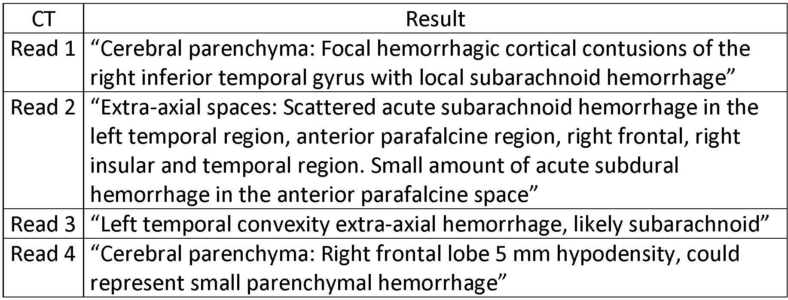
Early Detection Leads to Triage Perfection:
Head Trauma Screening Tool in Emergency Room Setting
Samuel Hawkins MD, Margaret Yoder BSN, RN, Sarah Stigelman MSN, RN, Joshua Hazelton DO, Jeffrey Lubin MD, MPH, Ryan Staszak MD
Introduction
Intracranial hemorrhage (ICH) can occur in patients sustaining low mechanism head-strikes, making timely diagnosis critical in this patient population. Delays in obtaining computed tomography (CT) scans may occur due to an increase in Emergency Department (ED) volume nationwide, thus necessitating additional means of screening and triage of patients with possible ICH. The Infrascanner is a handheld device that uses near-infrared technology to detect intracranial hemorrhage with 88% sensitivity and 91% specificity when compared to CT. We performed a prospective, observational pilot study to assess ease of use and feasibility of incorporating the device into the resuscitation and triage of low to moderate risk adult trauma patients in a busy rural Emergency Department.¹
Results
Sixty-five patients were enrolled and 62 (95%) underwent scan without interrupting the initial resuscitation and before the patient underwent CT scan. The average time for initial Infrascan readings was 4.58 min, with a median of 4 min. Of the 65 subjects, 60 had corresponding head CT performed. Three of 60 had a positive Infrascan reading with negative corresponding CT result (false positive rate 5%). Four of 60 (6.7%) returned a positive CT result for a type of intracranial hemorrhage that exceeded the detection capability of the Infrascanner. Of these 4 ICHs, none required surgical intervention.
Discussion
The most significant challenge was occiput contact measurements given patient positioning due to spine precautions and cervical collars. At times, this increased scan times and required repeat measurements. However, those using the Infrascanner felt the efficiency in navigating these barriers increased as more scans were attempted and this is reflected in the decreased scan times as the study progressed. Lastly, the Infrascanner did not miss any ICH requiring neurosurgical management. There were four missed ICH by the Infrascanner that were detected on CT. However, when investigating the size of theses hemorrhages, they were outside the Infrascanner detection ability or not surgically significant.
Infrascanner Detection Abilities:
Detects hematomas greater than 3.5 cc
Detects hematomas up to 2.5 cm deep from the surface of the brain (or 3.5 cm from the skin surface)
In patients with Epidural, Subdural and Intracerebral hematomas: Sensitivity = 88% / Specificity = 90.7%
Allows novice users to use the device by following simple graphic instructions¹
Mean: 4.58 min
Median: 4 min
Conclusion
We demonstrated that the Infrascanner can be used during the initial resuscitation of trauma patients without disruption or delay in providing current standard of care. The clear improvement in scan time with increased usage provides promise this device can be used by novice operators and more easily incorporated into various settings. Finally, the results suggested an acceptable false positive rate, without missing large, clinically significant intracranial hemorrhages. Moving forward, we suggest investigating the use of this device as a triage tool in environments with limited access to advanced imaging.
Methods
Eligible subjects were identified from a convenience sample of hemodynamically stable adult trauma patients being evaluated for possible ICH as a result of a low velocity mechanism. We excluded individuals with large, superficial cephalo-hematomas or GCS <13. Study team nurses responded to the ED and screened patients upon arrival. The Infrascanner was used to scan 8 predetermined areas of the head. Members of the treatment team were blinded to the results of the Infrascanner. The time to completion of the scan was recorded, and the results were compared to CT.
Positive CT Scan Results
References
¹C. Robertson, E. Zager, R. Narayan, N. Handly, A. Sharma, D. Hanley, H. Garza, E Maloney-Wilensky, J. Plaum, and C. Koenig, "Clinical Evaluation of a Portable Near- Infrared Device for Detection of Traumatic Intracranial Hematomas," Journal of Neurotrauma, vol. 27, pp. 1597-1604, 2010

